Slide 1


POWER BI PROJECT ON
BANK TRANSACTION

Slide 2
OBJECTIVE
The main objective of bank transaction analysis is to maximize profitability while minimizing risks, ensuring compliance, and improving customer experience.
Understand Customer Behavior – To analyze how customers spend, save, and borrow, helping the bank offer personalized services.
Revenue & Profitability Tracking – To identify which products (loans, savings, credit cards) generate the most income.

Slide 3
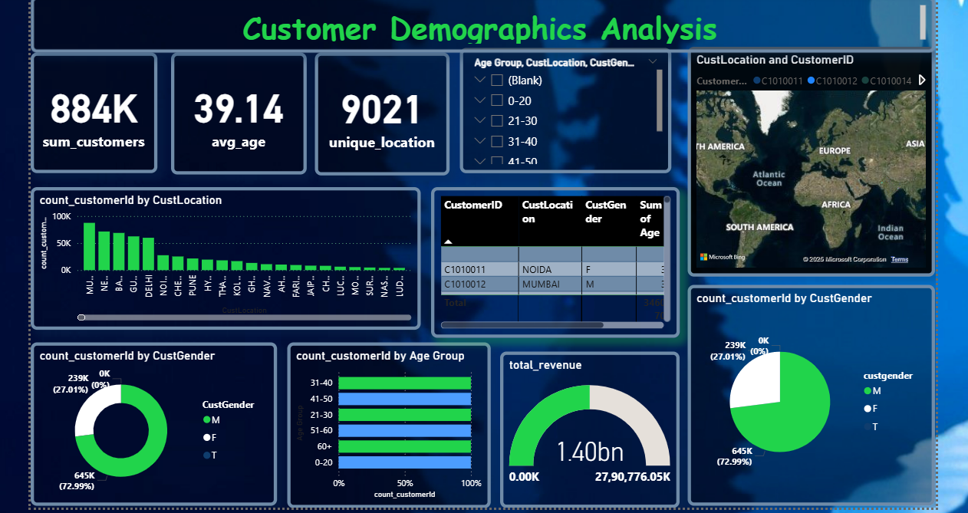

Slide 4
1. Customer Demographics Analysis
Key Insights:
Total customer base is 884K across multiple locations
Customer distribution is uneven, concentrated in top cities/regions
Male customers form the majority of the base
Average customer age is around 39 years.
Locations with higher density also contribute more to transactions.
Gender skew indicates potential to improve engagement with female customers
Mid-career age group (30–40) is the dominant customer segment

Slide 5
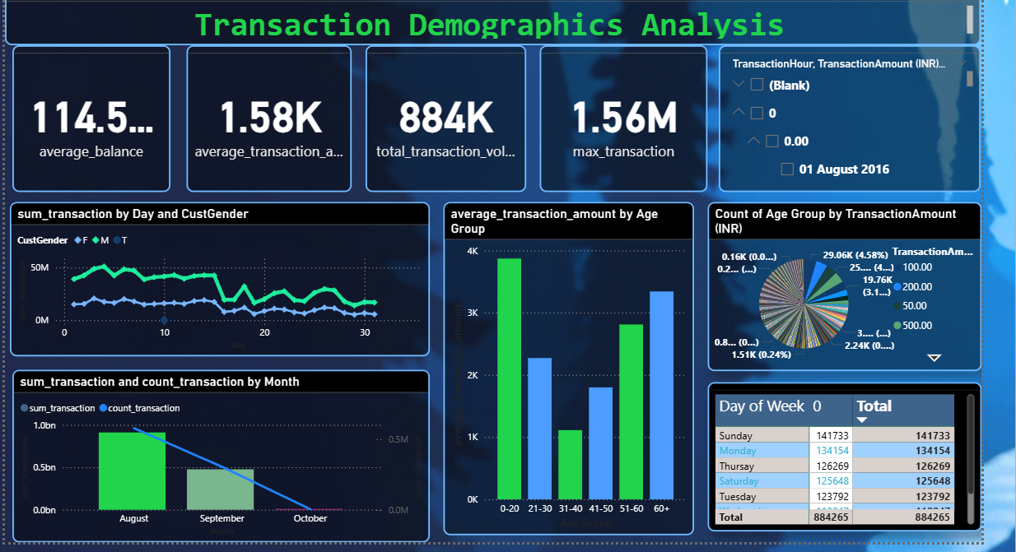

Slide 6

2. Transaction Demographics
Key Insights:
Peak transactions occur during specific days of the week
Certain time windows (hours of the day) show higher activity
Customers aged 31–40 have higher average transaction values
Senior customers (60+) show high-value but lower-frequency transactions
Younger customers (21–30) transact more frequently but at lower values
Gender patterns show males dominating in transaction count/amount.
Outlier transactions exist with very high amounts, requiring fraud checks

Slide 7
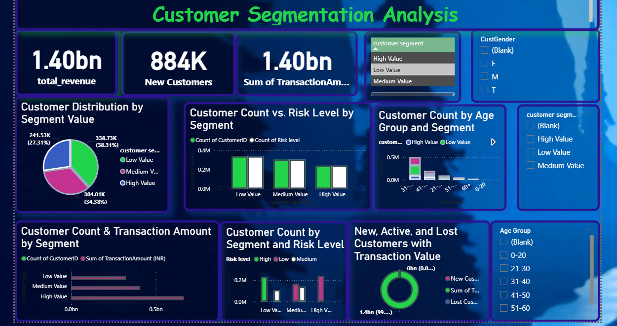

Slide 8
3. Customer Segmentation
Key Incites
High-value customers generate the majority of transaction revenue
Medium-value customers represent the largest group by count
Low-value customers have low balances and contribute least to revenue
High-value customers show strong loyalty but are smaller in number
Medium-value customers are the best target for upselling into high-value
Low-value customers are more prone to churn and need retention campaigns
Segment conversion (medium → high) is key to improving long-term revenue

Slide 9
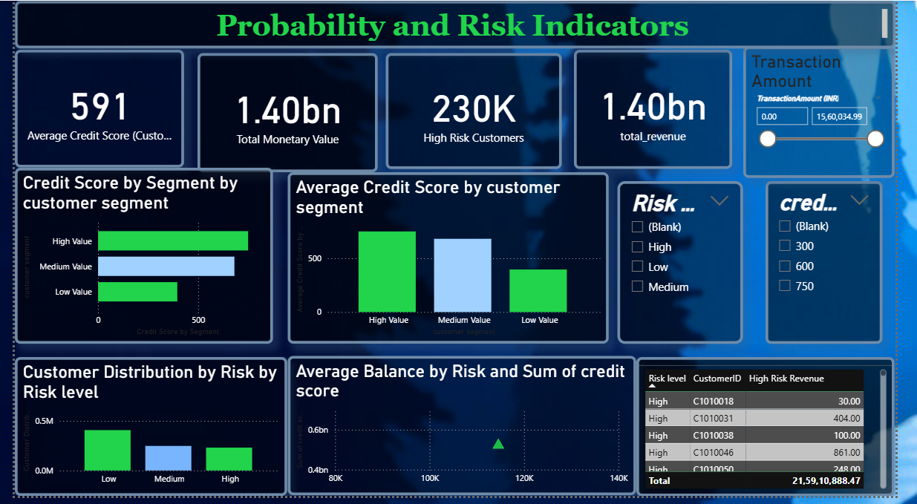

Slide 10
4.Profitability & Risk Indicators
Key Insights:
High-risk customers hold significant exposure despite being fewer in number
Medium-risk customers form the majority of the base
Low-risk customers have the highest stability and lowest default chances.
Revenue contribution is not directly proportional to risk — some high-risk customers generate large revenues.
Credit score distribution is skewed towards medium-risk levels
High-risk customers need monitoring, stricter limits, and tailored credit strategies.
Average customer credit score is around 590

Slide 11
Recommendations
Target medium-value customers with upsell/loyalty programs.
Strengthen credit risk controls for high-risk customers.
Personalize offers by age and gender demographics
Use time & location patterns for optimized campaigns.
Build segment-specific retention & loyalty strategies.
Launch financial literacy programs to improve customer credit scores.
Introduce tier-based rewards to motivate customers to move up in segments.
Optimize transaction fees by segment to balance profitability and inclusivity.
Use predictive analytics to forecast churn and proactively retain customers

Slide 12
Conclusion
The Bank Transaction Analysis highlighted how different customer segments contribute unevenly to revenue and risk.
High-value customers generate the majority of profits, while low-value/dormant accounts increase operational costs.
Risk factors like defaults, overdrafts, and fraud are concentrated in specific demographic groups (youth, elderly, rural).
Cross-selling & multi-product adoption emerged as key drivers of long-term profitability.

Slide 13

THANK YOU
Presented By:
Anvesh Darshinala Shanti

